Slide 1

BUILDING A NEWS SUMMARIZER
PyExpo 2021 - 22

Slide 2
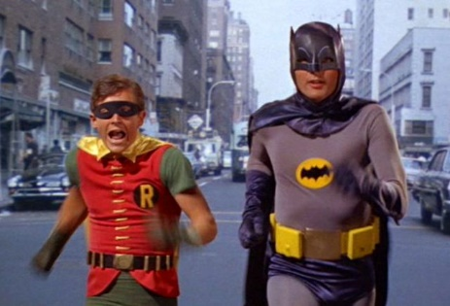
TEAM NUMBER:19
TEAM MEMBERS:
Keshav K V (1st Year CSE Department)
Kavin Karkki P (1st Year CSE Department)

Slide 3

Problem Statement :
What we’re going to do is convert information from any news source (we’ll basically use the news link on a website) into the short text to provide a superficial and multiple reading.

Slide 4

Aim and Moto
News summarization is the task of creating a short, accurate, and fluent summary of an article.
A popular and free dataset for use in text summarization experiments with deep learning methods.
Automatic news summarization is the task of producing a concise and fluent summary while preserving key information content and overall meaning.

Slide 5




Libraries Used

Slide 6



Slide 7
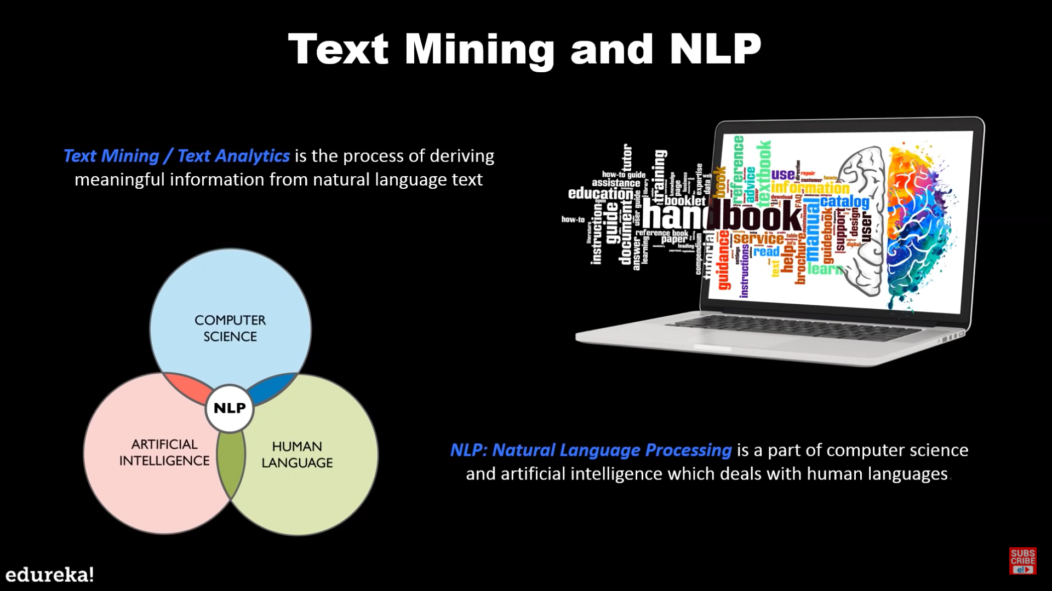

Slide 8

Summarizing The News Data Using the Following Steps…

Slide 9
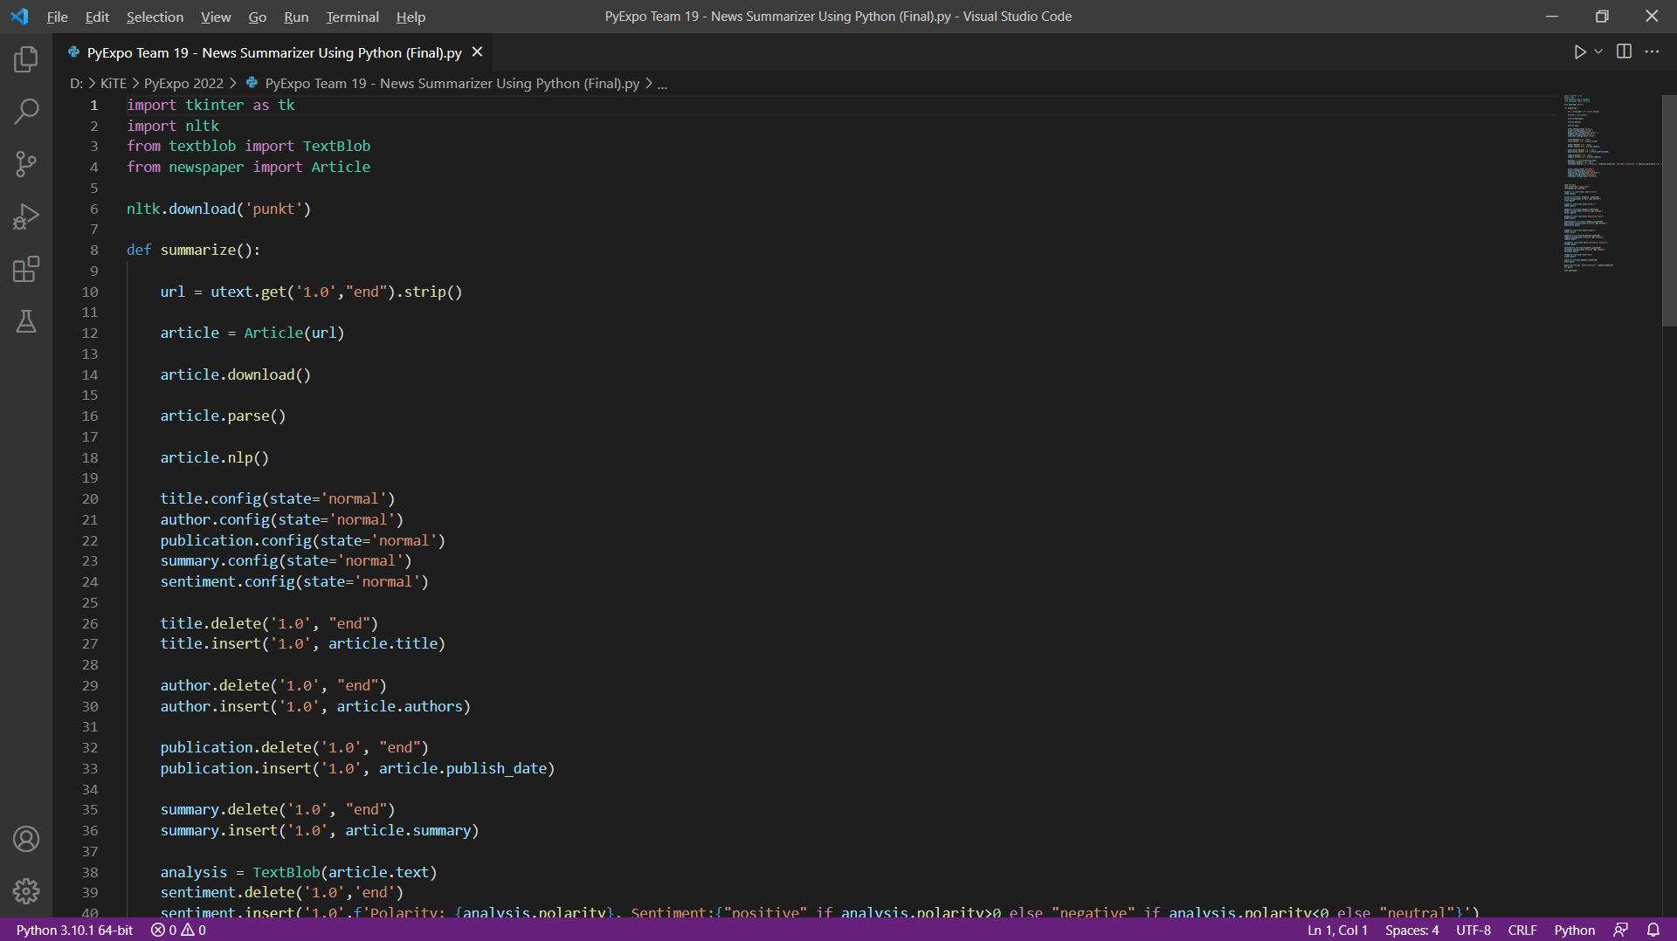
Functioning Steps :-
Step 1:
Step 2:
Step 3:
Step 4:

Slide 10
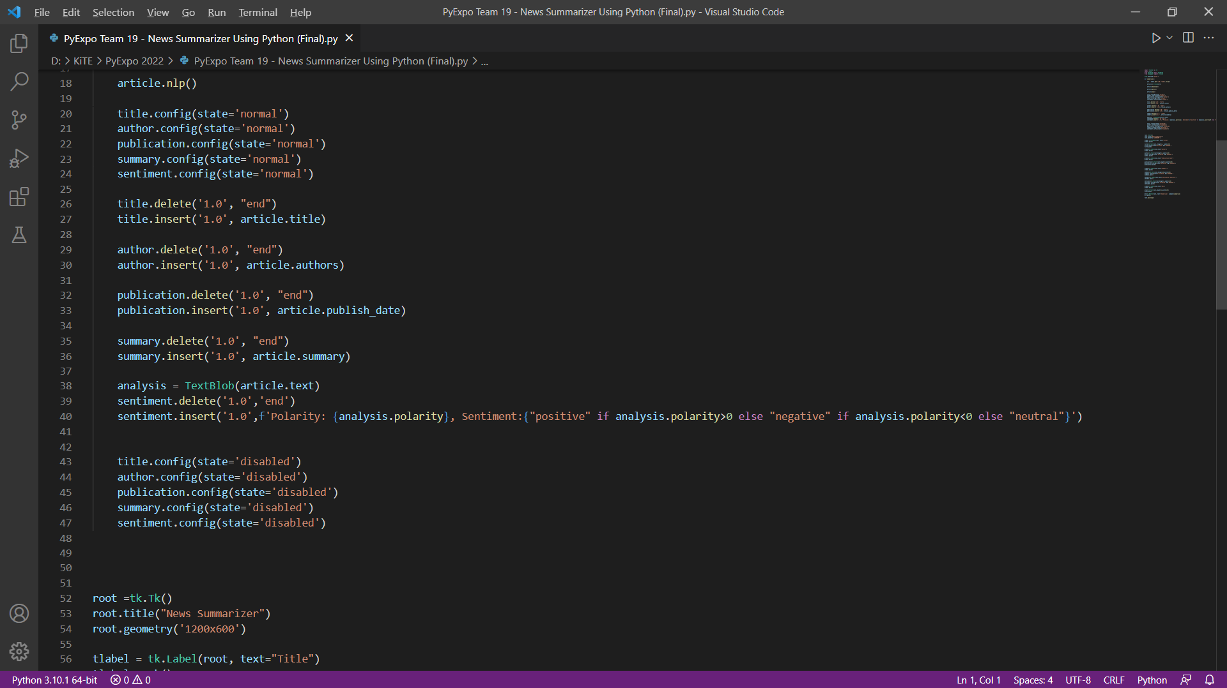
Step 5:
Step 6:
Step 7:
Step 8:

Slide 11
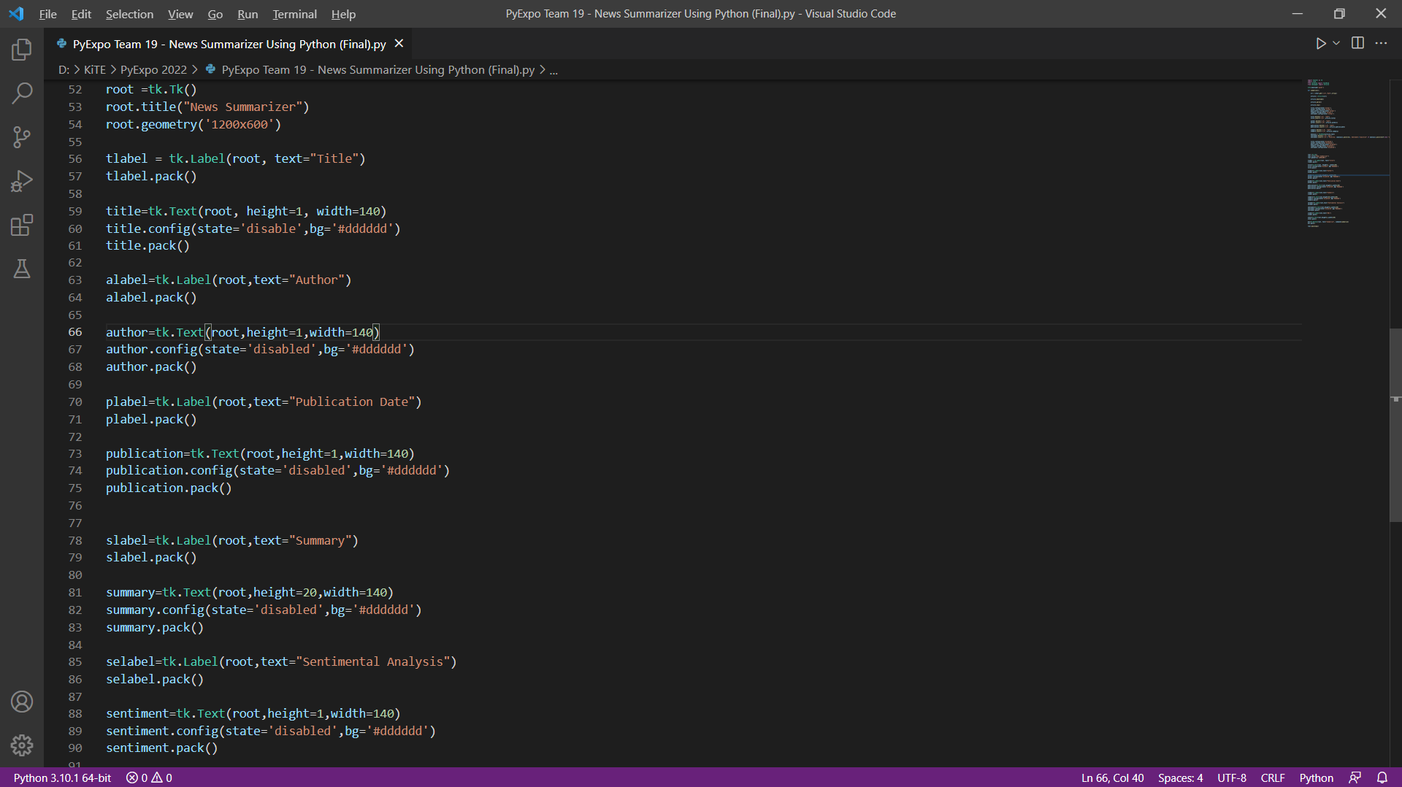
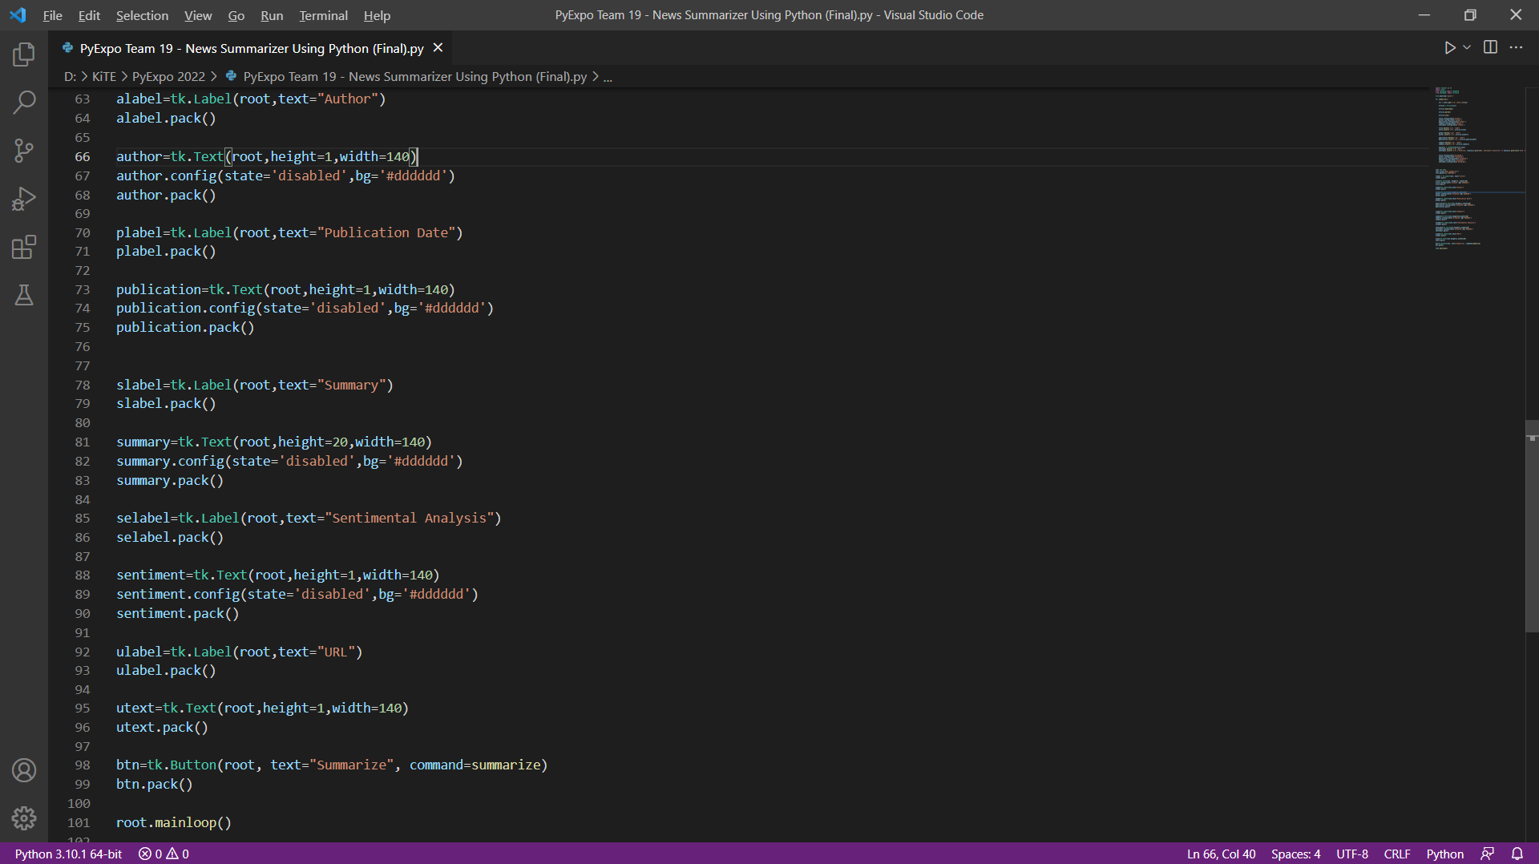
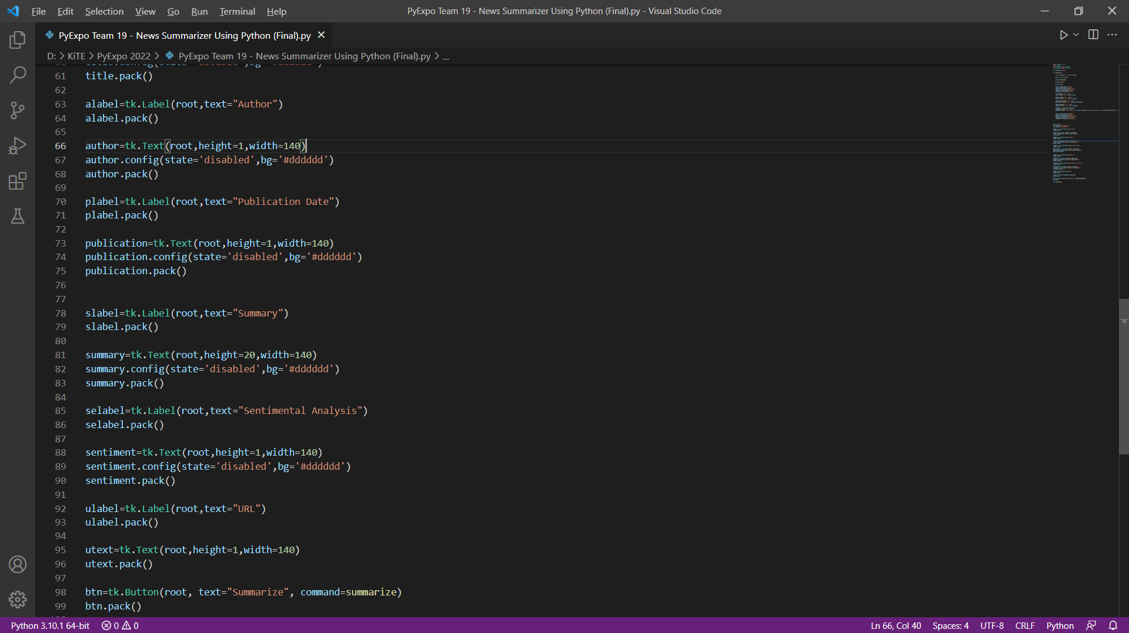
Step 9:
Step 10:
Step 11:

Slide 12
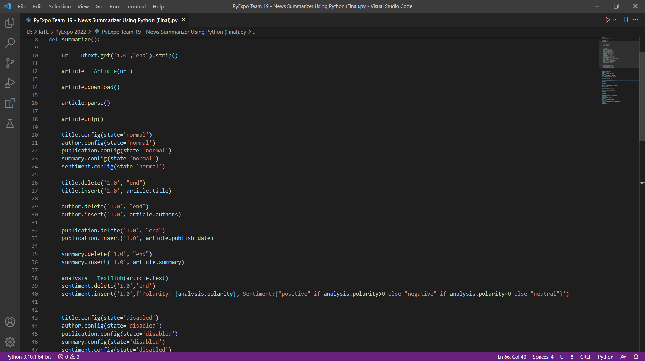
Step 12:

Slide 13

Final outcome !

Slide 14
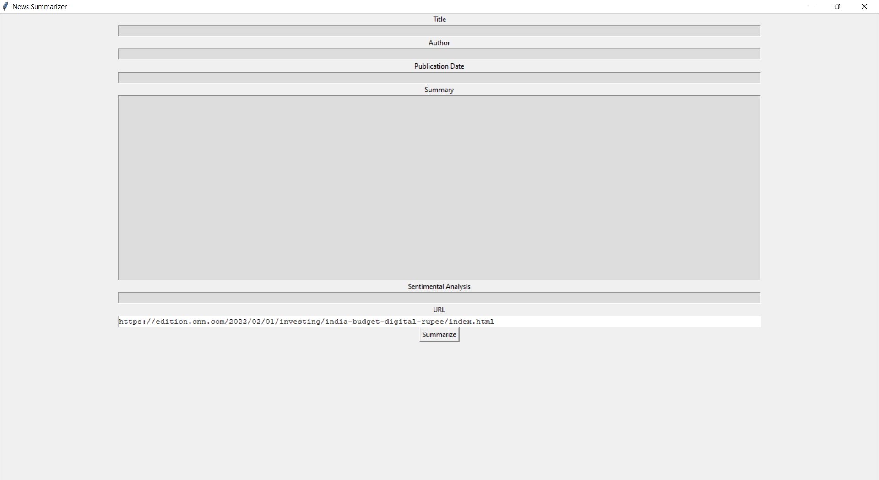
Input

Slide 15
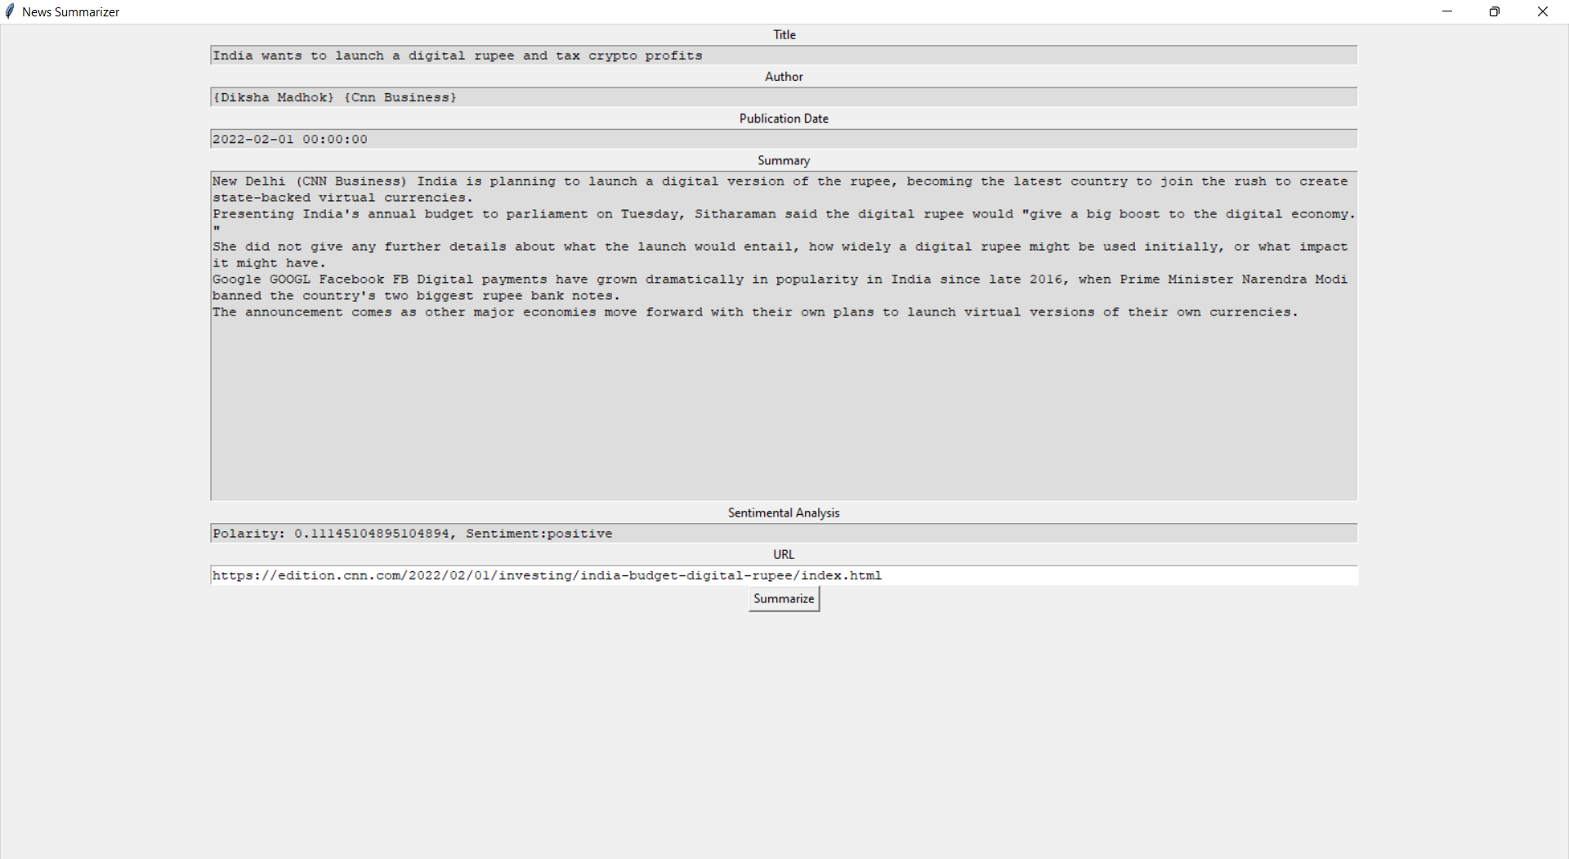
Output

Slide 16
Applications Of Natural Language Processing

Slide 17
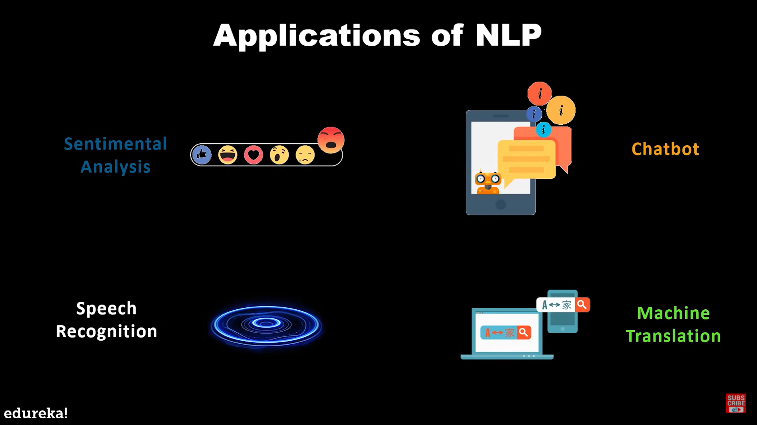

Slide 18
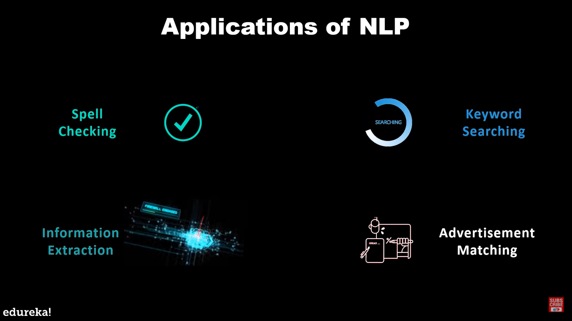

Slide 19

Applications of Our News Summarizer In Real Life !!

Slide 20

Important NLP task for years due to its diverse applications
News headline generation,
Weather forecasting,
Emails filtering,
Medical cases,
Recommendation systems,
Machine reading comprehension (MRC)

Slide 21


Time saving.
Streamline processes.
Sentiment analysis
Identify the information from large databases.
Faster customer service response times
Data abstracted.
single and specific task.
Unpredictable

Slide 22

Conclusion
In this project, we have brought a Python solution for those who want to read the news that is curious on news sites in a more brief way or who want to perform similar processes faster due to their work. When we adopt automation to real life, we can undoubtedly have this fun more comfortable.

Slide 23
This won’t be possible without you guys !
Thankyou
Our Mentor : Mr. Prijesh Devanand (3rd year IT department)
Our Faculty Mentor : Ms. V Kamala (CSE department)

Slide 24


Slide 25


Thankyou All For Your Attention !

